Slide 1
Crafting Successful Funding Applications
A checklist!
Notes:
Ailsa McAllister Depute CEO
Here today to provide you with an overview around how to craft successful funding applications. I have created a hand out for you to take wasy to day to help you as a guide in the form of a checklist.

Slide 2
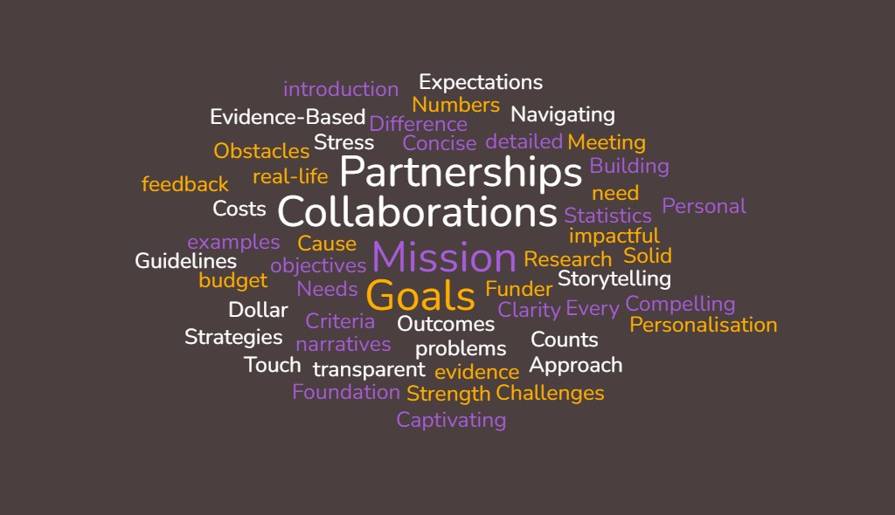

Slide 3
Before you start!
Will you be duplicating efforts of another project locally?
Could others be part of the cause?
How do you know that this project/service is needed
How would the project/service help?
Notes:
Thinking about your project. Do you know of any other groups currently delivering something similar?
Do you know groups that may collaborate with you in your quest for funding and project delivery?
What are the identified needs for your project? Evidence, Needs Analysis, Statistics, Research, News articles etc....
What problems will your project/service solve?

Slide 4
Does your application?
5. Say what you will achieve?
6. State the scale of the difference you will make?
7. Outline how you will evidence this?
8. Quantify exactly how much money you will need, and, how you will spend it?
Notes:
5. set out your mission, goals, actions, objectives and outcomes?
6. Can you articulate what difference your project will make
7. How will you chart success and demonstrate impact?
8. Can you state how much money you will need?
9. Will you be able to demonstrate how every penny will be spent?

Slide 5
Questions to ask yourself
9. Have you communicated with the funder to ensure that all the information required has been presented
10. Is your writing clear? Do you know exactly what you want to achieve and have you set this out concisely.
11. Have you pre-empted any problems that may come up throughout the project and planned for any contingencies required?
Notes:
Does the project, service I am applying for align to the funders goals, mission, objectives, and, are we both looking to achieve the same outcomes?
Is your writing clear? Do you know exactly what you want to achieve and have you set this out concisely.
Can you anticipate any problems that may come up throughout the lifespan of your project?

Slide 6
Thank you for listening!

