Slide 1
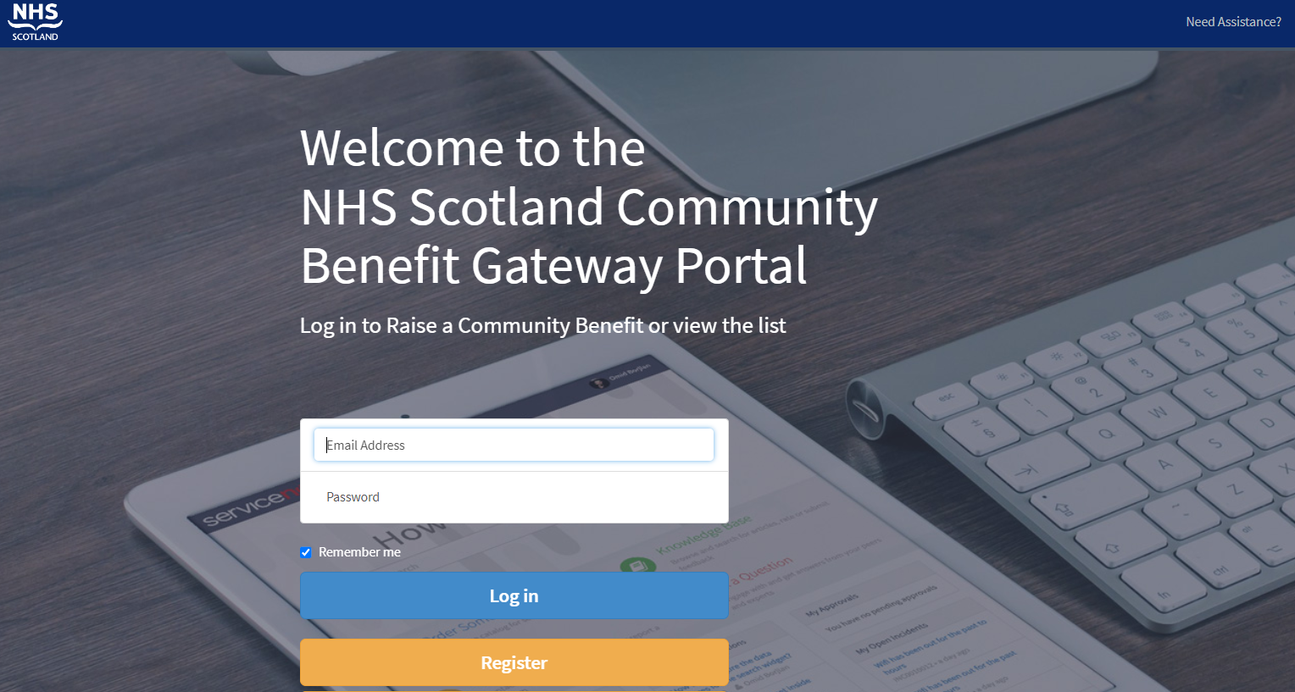
Community Benefits Gateway Portal
Phillippa MacDonald
Health Promotion Officer
Directorate of Public Health
NHS Tayside

Slide 2
What is the Community Benefits Gateway (CBG)?
What are community benefits?
Community benefits are contractual agreements that can be included in public contracts and frameworks between a contracting authority and a supplier.
In Scotland, the award of public contracts are regulated by the Procurement Reform (Scotland) Act 2014. Within the act, there is the Sustainable Procurement Duty which requires the contracting authority to consider how in conducting the procurement process it can improve the following aspects:
Social
Environmental
Economic growth
Reducing inequalities
The CBG is an online platform that connects community organisations with NHS Scotland suppliers in order to identify and deliver community benefits.
The system is design to enable NHSS’ suppliers to access a diverse range of initiatives that are listed in the portal and provide subsequent support. Some examples include, working opportunities, environmental regeneration projects, provision of professional advice, etc.

Slide 3
NHS Tayside’s Public Health Priorities
Improving Mental Health & Wellbeing
Reducing Substance Use
Financial wellbeing
Obesity & physical activity
Environmental sustainability

Slide 4
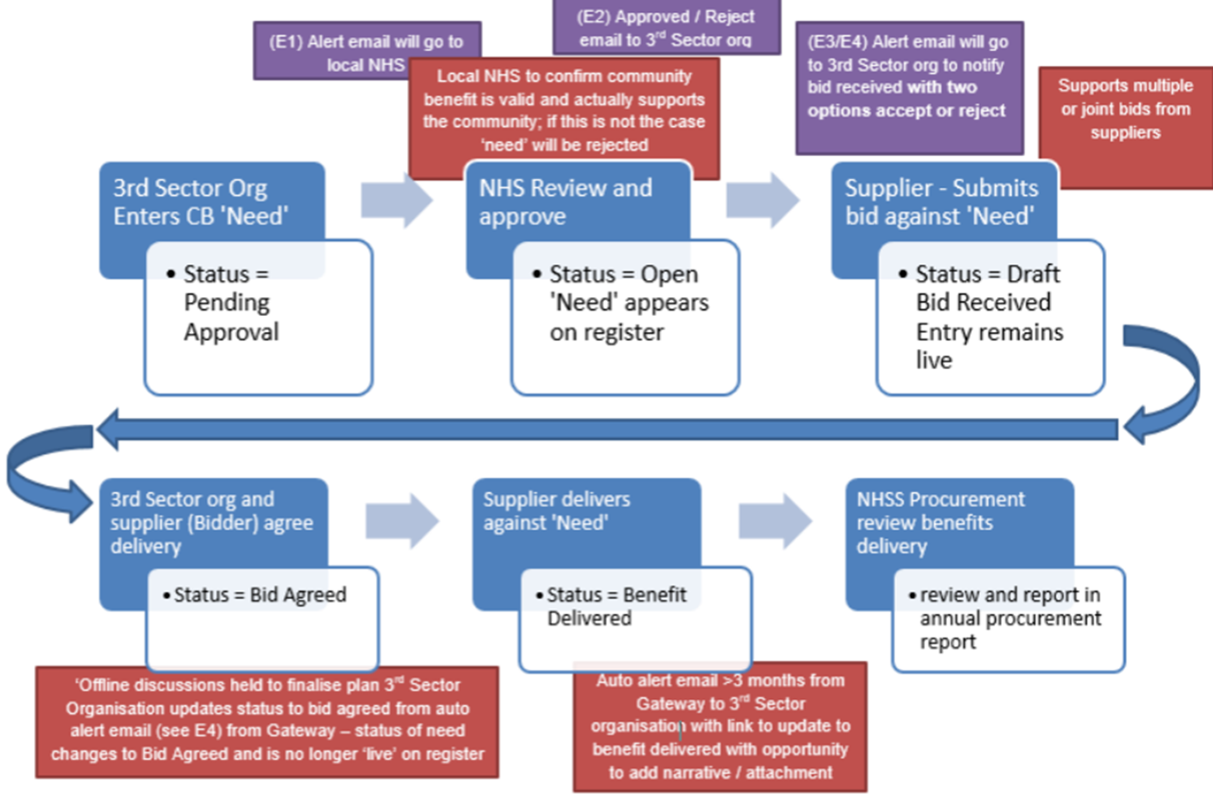
How does it work?
Workflow and status of a
‘community need’ request

Slide 5
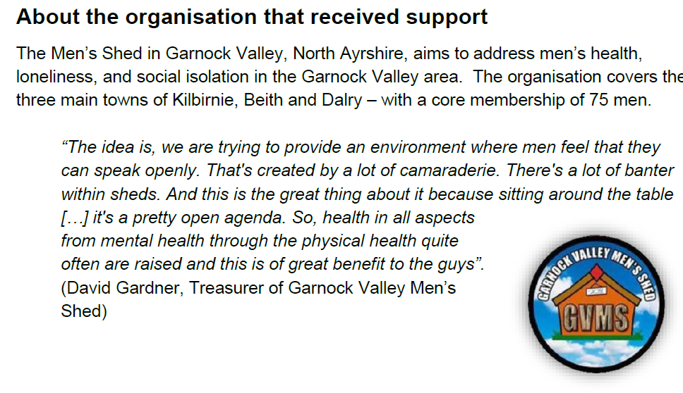
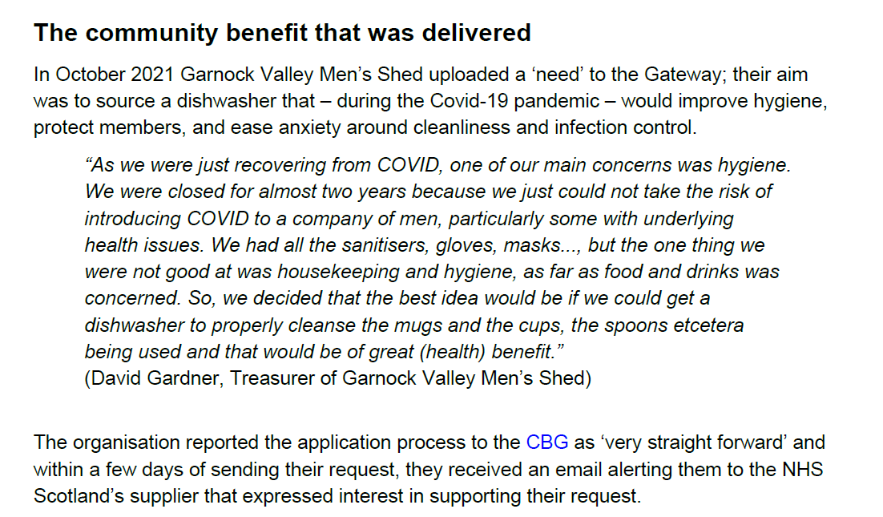
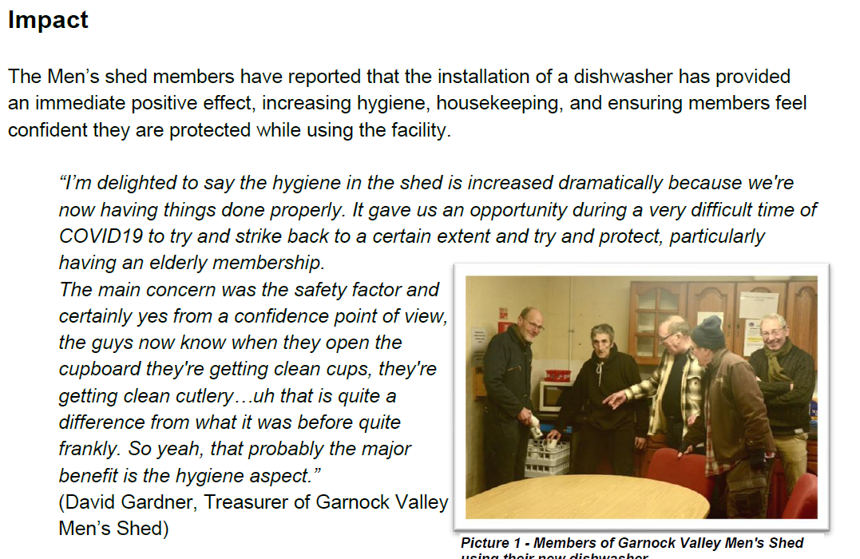
Case Studies

Slide 6
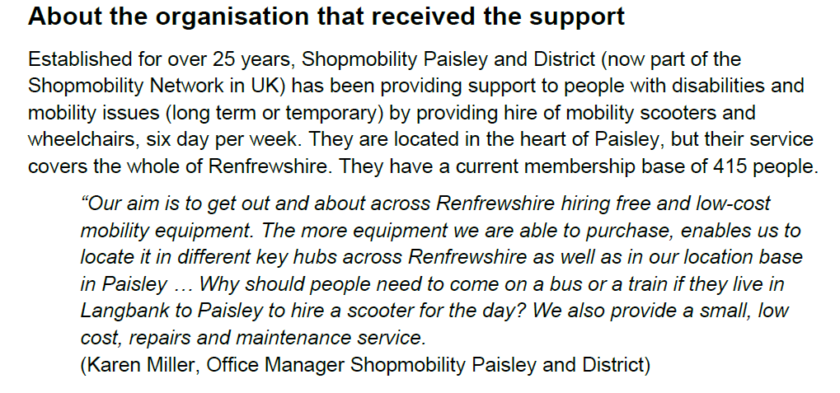
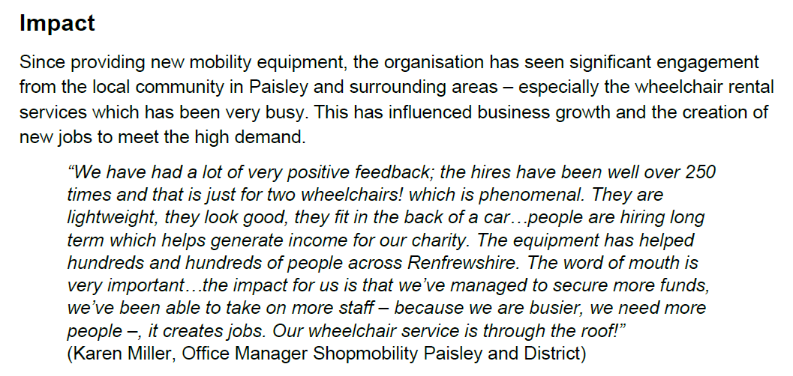
Case Studies

Slide 7
How to submit a ‘community need’?
You will first need to register by completing the registration form.
1. Go to https://nhsnss.service-now.com/community_benefit
2. Click ‘Register’, then a new screen will appear; complete the registration form and click ‘Submit’.
3. An email with a temporary password will be sent to the email address you’ve registered with. Follow the instructions on the email.
Once registration is completed:
4. Go back to https://nhsnss.service-now.com/community_benefit introduce your user (i.e., email) and password and click ‘Login’
5. A new screen will appear, click ‘Register a community need’
6. Complete the ‘community need’ form
7. Click ‘ Submit’ and that’s it!

Slide 8
Online information available
For more information and support materials, on the portal please visit the following websites:
Direct link to the CB Gateway:
https://nhsnss.service-now.com/community_benefit
NSS website > CB Gateway
https://www.nss.nhs.scot/procurement-and-logistics/sustainability/access-our-community-benefit-gateway/
PHS website > CB Gateway
https://publichealthscotland.scot/our-organisation/procurement/community-benefits-gateway/
Animation
https://www.youtube.com/watch?v=RyeU_4-Ztg0

Slide 9
Further questions, feedback….
NHS Tayside CBG inbox
tay.communitybenefitgateway@nhs.scot
CB Gateway National Team
nss.combenstriage@nhs.scot

