Slide 1
Community Wellbeing Centre
Engagement & Involvement Process/Feedback
Why?
Who?
How?
What we learned?
What next?

Slide 2
WHY DID WE COLLECT/GATHER FEEDBACK?
Through DVVA 3rd sector involvement in MHSPG/ CUC Pathways were tasked with leading on the city wide engagement and involvement through a stakeholder group.
DVVAs role is to ensure that people living in Dundee can have their say in the development of the CWC.
Ensure the local community has the opportunity to contribute meaningfully to on-going development of centre
Inform the service specification for allocated 3rd sector provider
We will not be running the CWC. That will be run by whichever voluntary organisation wins the contract.
Notes:
According to these figures from the ONS from 2019-2020 97% of households in the whole of the UK had access to the Internet putting the UK considerably higher than Europe, which was collectively sitting at 91%. These figures look really promising at first glance but we know from local forums and community engagement in Scotland that there is a much more complex picture.

Slide 3
Who gave us their ideas?
Local People in East and West
Third Sector Service Providers
DVVA DHMN and Mental Wealth Academy
NHS Health and Wellbeing Networks
Community Health Inequalities Team networks
Themed sessions 68 participants

Slide 4
HOW DID WE DO THIS?
Facilitating the stakeholder group which is the focal point for engagement
Fully inclusive approach
Coordinating survey monkey questionnaire for wide distribution
Facilitating themed online sessions for open dialogue & discussion
Facilitated and advised on conversations café’s
DVVA Website

Slide 6
Access to the centre
‘’The centre should be 24/7 available for all with lots of options, calling up, texting, being referred, an outreach service, paid taxi service. Then whatever the case the first person they see should be very welcoming, approachable and trained. It is having lots of options’’ Participant theme session 1
Taxi
ElectricPoolCars
Options
SecuritynotBouncers
Welcoming
FreeBus

Slide 8
Services
What services and people should be provided by the Centre?
‘’There should be information that is visible and accessible for all with a mixture of opportunities from complimentary therapies, to work shops on self help skill with people in helping with housing, benefits etc’’ Participant themes session 1

Slide 9
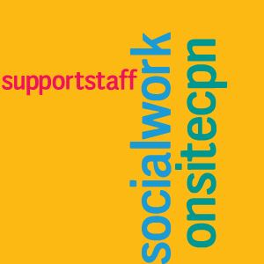
People
‘’There should be a mix of clinical and non clinical staff and clinical staff should wear a uniform. There should be volunteers and people with lived experience but everyone should be fully trained on de-escalation e.g’’ Participant themed session
Clinical
Peer Mentor
PWLE
Befriender
Listening service
Police
SocialWork
OnsiteCPN
SupportStaff
Trained
Volunteers
Counillors

Slide 10
Building Space/ Physical Environment
What should the building space or surroundings of the Centre be like?
Warm, Art, Colour Therapist
Comfy seats, mixture, unclinical
Disabled Access
Café, Drinks, Snacks, café as waiting area
Plants, outdoor green space, Flowers
Sound proof room, confidential, Private area

Slide 11
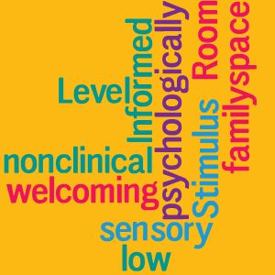
Building Space/ Physical Environment
‘’The building should first and foremost be welcoming and I would suggest consulting a colour therapist and ensure also it is a psychologically informed environment’’ Participant theme session 2

Slide 12
Emotional Needs
How should the emotional needs of the person accessing the CWC be met?
Walk
Safe Space
De-escalation
DBI
Variety People
Solution focused
Consider children
Needs Based
Access to Dr
Access to medication
Communication solutions
Active Listening
‘’There has to be a variety of support it is not one size fits all. People hate having to repeat themselves to lots of different people consistency of staff is important. It needs to be person centred’’ Participant themed session 2

Slide 13
Families and Carers
Holistic approach
Involved
Supported
Workshops
Respite
Signposting
Opportunity to talk
Links to CAHMS
Post suicide support
Gendered approach
Family liaisons officer
Creche service
Carers centre
How can the CWC support the needs of families and carers?
‘’The family member or carer should be involved, informed and supported from the start. Involving the carer in the assessment gives a holistic view. So the outcomes would be better. Running workshops on how to live with someone with a mental health condition or poor mental wellbeing. Often the family member or carer ends up with their own mental health issues because they have no support’’ Participant themed session 2

Slide 14
What Next?
Thank you to everyone who has been involved!!
This Photo by Unknown Author is licensed under CC BY

