Slide 1

COMMUNITY WELLBEING CENTRE
Stakeholder Group 2
Agreeing the process for detailed design discussions
Linda Graham

Slide 2
DUNDEE’S COMMUNITY WELLBEING CENTRE ... remember
We have some ‘givens’ from Tayside work but will be about the functions we need to provide, not how we do it and what is looks/feels like
This group will advise what our CWC should be like ... And we will work to deliver that

Slide 3

COMMUNITY WELLBEING CENTRE
Proposal is that we think about the journey into and through the CWC ...
And use that to break down the task into manageable chunks

Slide 4

ADVANTAGES ...
More detailed discussions
Not everyone feels comfortable in large groups

Slide 5
Journey to & through CWC
In what ways should
people be able to
access the CWC?
What supports will
people and families
need to make contact/
access the CWC?

Slide 6
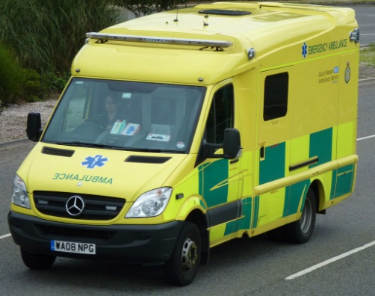
Journey to & through CWC
Who else should
Support people to
access the CWC?

Slide 7
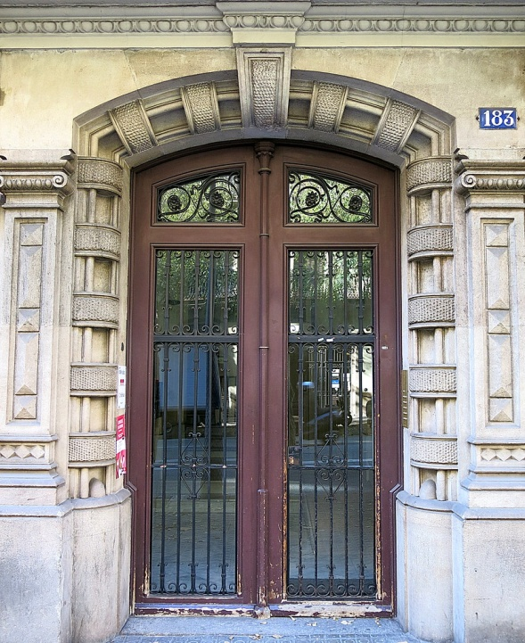
What will the immediate ‘meet & greet’ be like?
What do people need from
the outset? What do they
Need first?
What should the
Environment be like?
What do families &
Supporters need?

Slide 8
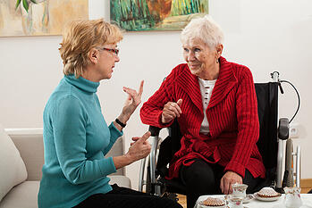
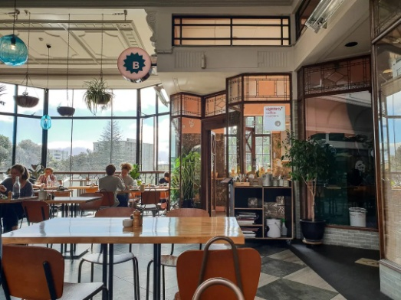


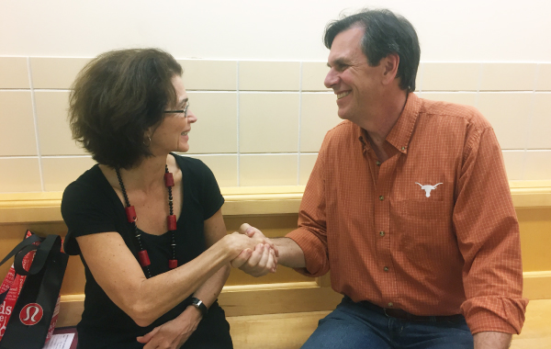
What support do people experiencing high distress need?

Slide 9
What support do people experiencing high distress need?
What do we deliver
From within the
CWC?
What do we support
People to access in the
community?

Slide 10
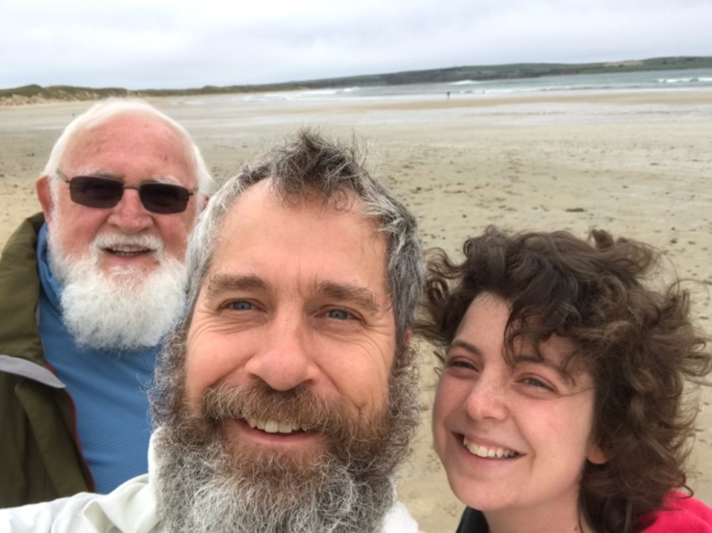
What support do people experiencing high distress need?
Are family needs different from that?

Slide 11

Environment?
What should our rooms and furnishings look like?
What should our cafe area be like?

Slide 12
People?
What should our staff group be?
Should volunteers be a key part of our model?
Should peer supporters be a key part of our model?
Who else?

Slide 13
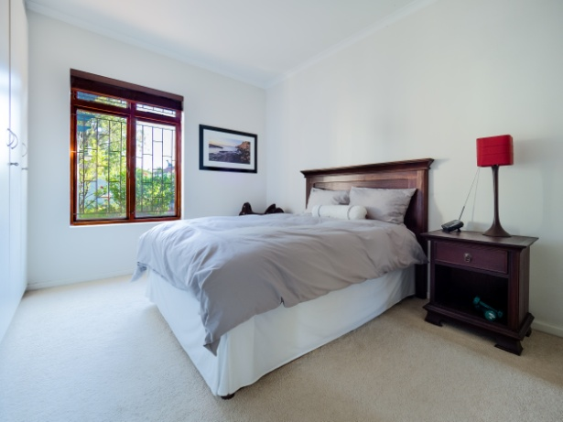



Accommodation with support
All the same questions will need asked
Around accommodation with support ...
But not today!

Slide 14
Summary of design tasks
Access
Arriving
Supports
Families
Environment
People
What else?

Slide 15



